Slide 1

GLOBAL MORTALITY PATTERNS: TRENDS, AGE GROUPS, AND COUNTRY DIFFERENCES
Pappula Madhusudhan Reddy
MIS 7397 - Data Visualization
March 9, 2026

Slide 2
DATASET DESCRIPTION
Dataset Used
Source: Institute For Health Metrics And Evaluation (IHME) – Global burden of disease dataset.
Years covered: 1970 – 2010.
Key Variables
Country
Year
Age Group
Death Rate per 100,000 people
Sex
Purpose Of Analysis
To explore global mortality trends, demographic differences, and geographic disparities.

Slide 3
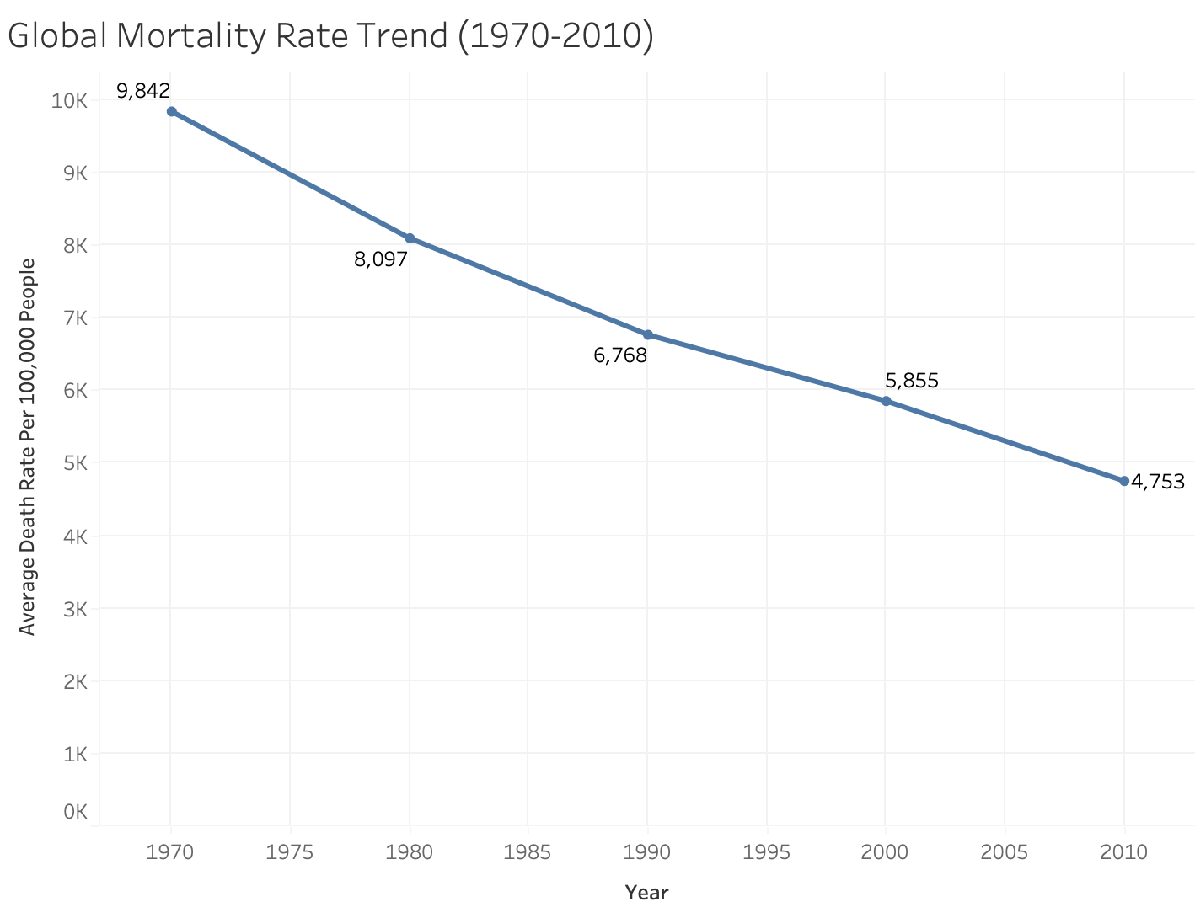
MORTALITY TREND OVER TIME
Insight:
Global mortality rates declined by roughly 50% between 1970 and 2010.
This represents a major improvement in public health, medicine, and disease control.

Slide 4
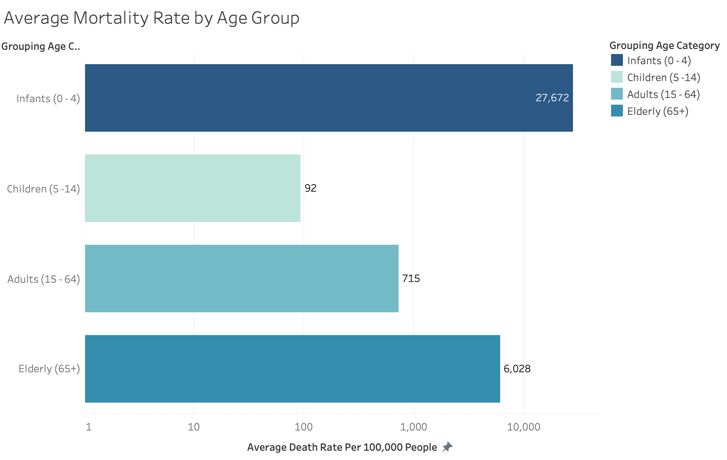
MORTALITY BY AGE GROUP
Insight
Mortality follows a U-shaped pattern:
Highest among infants.
Lowest during childhood and adulthood.
Increases again among the elderly.

Slide 5
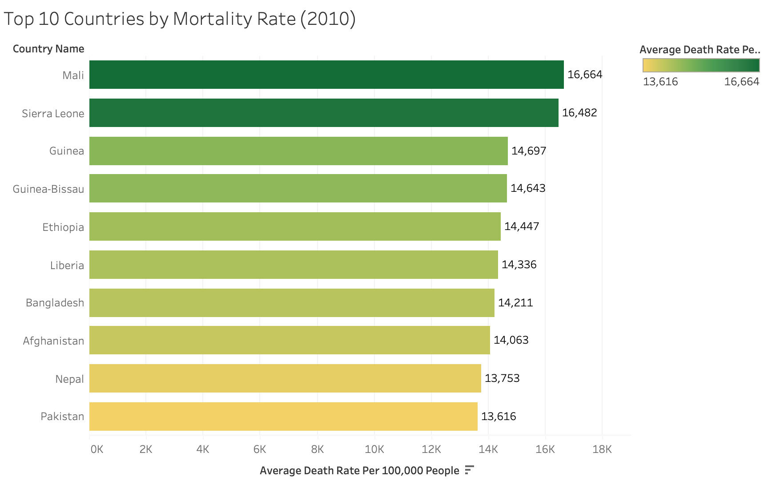
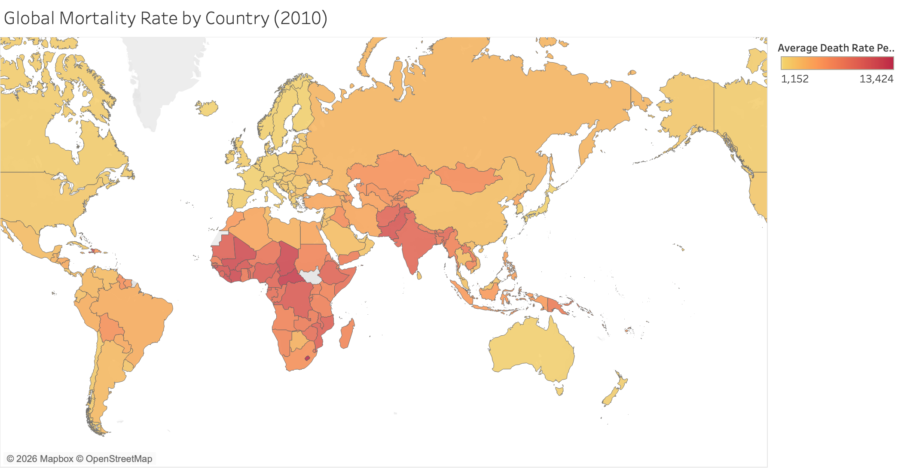
COUNTRIES WITH HIGHEST MORTALITY RATES
Insight
High mortality rates are concentrated in parts of Sub-Saharan Africa and South Asia.
The map supports the bar chart by showing that high mortality is geographically clustered, not random.

Slide 6
KEY TAKEAWAYS & RECOMMENDATIONS
Key Takeaways
Global mortality declined from 1970 to 2010.
Mortality is highest among infants and the elderly.
Mortality rates vary significantly across countries and regions.
Recommendations To Stakeholders
Strengthen maternal and child healthcare programs.
Improve healthcare access in high-mortality countries.

Slide 7
LIMITATIONS & REFERENCE
Limitations
Data covers 1970 – 2010 only.
Country averages may hide regional differences.
Data quality may vary across countries.
Reference
Institute For Health Metrics And Evaluation (IHME).
Global Burden Of Disease (GBD) Mortality Data. Seattle, WA: IHME, University Of Washington.
Dataset source:
https://www.healthdata.org/gbd
Course Material

